Slide 1

Group 4 – Technology Entrepreneurship

Slide 2
The Problem
Stressful experience searching for parking spaces
High cost of parking costs in high rise carparks
Time wasted spending 15 minutes looking for space
Traffic congestion caused by 30% searching cars
70% of parking fines go unpaid
Waste of paper with discs, tickets and fines

Slide 3
The Solution
Adding sensors to show available/booked spaces
Mobile application - booking system
Easier identification of illegal parking
Increasing efficiency

Slide 4
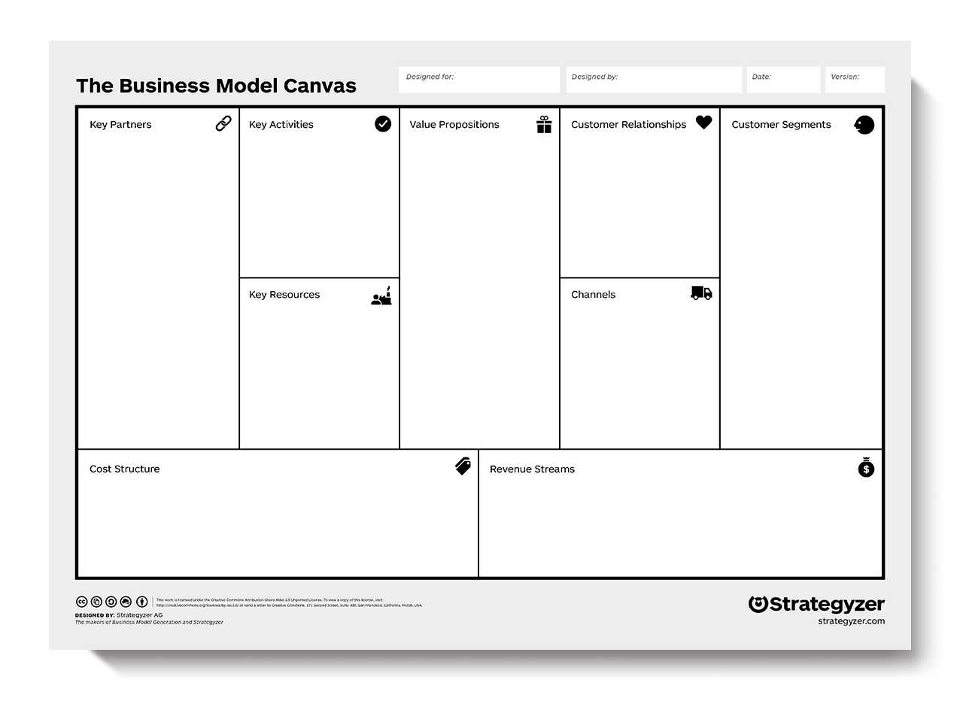
Smart Parking
Group 4
3/11/16
1.0
Problem Solving Production Installation Maintenance
Automated- Services
Paperless
Organisation
Council
Optimisation
Management
Automation
Revenue
Environmental
Council
Sensor Suppliers
Cloud Providers
Personal
Local Businesses
Drivers
Tourist
Technology
Physical
Labour
Intellectual
Financial
Face To Face
Telephone
Email
Value Driven
Technology
Labour
Licensing
Upgrading

Slide 5
Smart Parking
Group 4
3/11/16
1.0
Problem Solving
Education
Platform
Self-Service
Booking Service
Organisation
Council
Convenience
Cost
Environment
Health
Council
Sensor Suppliers
Cloud Providers
Personal
Local Businesses
Drivers
Tourist
Technology
Intellectual
Financial
Website
App
Parking Signs
Value Driven
Technology
Booking Fee (%)

Slide 6
Conclusion
Manageable easy booking system
Reduced Environmental Impact
Optimize the issuing of fines
Increasing efficiency

